Slide 1






Discovering Structure in Unstructured I/O
Jun He^{1,2}, John Bent³, Aaron Torres⁴, Gary Grider⁴, Garth Gibson⁵,
Carlos Maltzahn⁶, Xian-He Sun¹
¹Illinois Institute of Technology
²New Mexico Consortium
³EMC
⁴Los Alamos National Laboratory
⁵Carnegie Mellon University
⁶University of California Santa Cruz
November 12, 2012

Slide 2
Outline

Slide 3
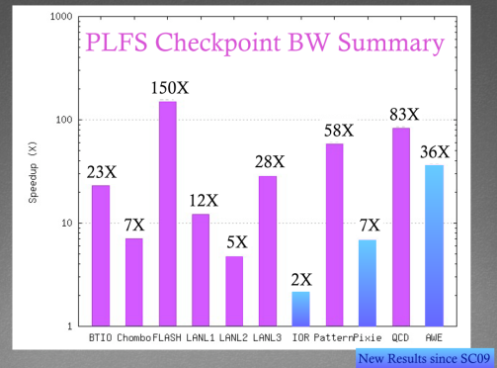
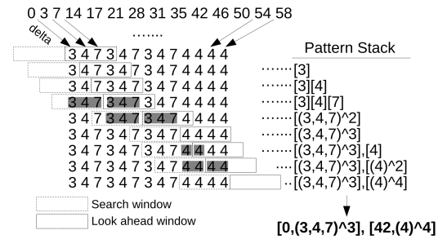
This presentation focuses on recognizing I/O patterns and representing them compactly.
PLFS (Parallel Log-structured File System) accelerates checkpointing significantly, but its internal metadata may grow too big.
How to recognize I/O patterns
and reduce PLFS metadata size.
Metadata size is reduced significantly and R/W performance is improved.

Slide 4
Motivation

Slide 5
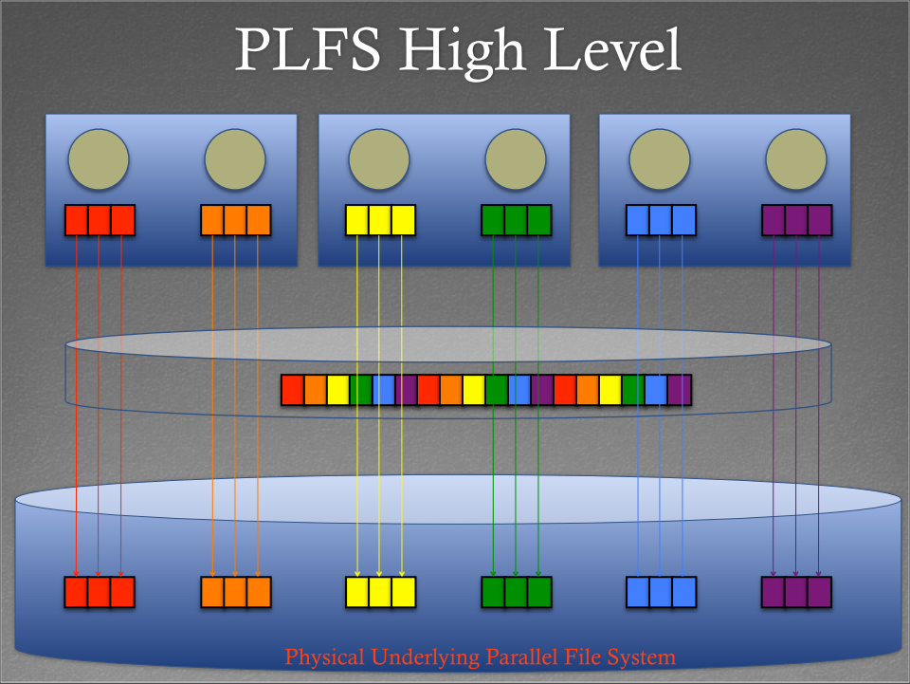

Checkpointing is the storage driver in supercomputers.
PLFS can improve checkpointing significantly.
Up to several orders of magnitude improvement.
PLFS transparently transforms N-1 write to N-N write.

Slide 6


PLFS internal metadata may grow very big.
Keep writing
Keep writing
Logical view
Proc 0
Proc 1
Hole
PLFS Reorganization
Physical File 0
Physical File 1
Logical
Offset
Length
Physical
Offset
Chunk
ID
Logical
Offset
Length
Physical
Offset
Chunk
ID
0 2 0 0
2 1 0 1
3 2 2 0
5 2 1 1
7 4 4 0
11 3 3 1
Index.0
(metadata)
14 2 8 0
Explode
17 2 10 0
16 1 6 1
21 4 12 0
19 2 7 1
28 2 16 0
25 3 9 1
31 2 18 0
30 1 12 1
35 4 20 0
33 2 13 1
42 3 24 0
39 3 15 1
46 3 27 0
50 3 30 0
Index.1
(metadata)
54 3 33 0
58 3 36 0

Slide 7

Applications’ I/O has patterns and they can be represented compactly.
Pattern of LANL anonymous 3.
Colors indicate ranks.

Slide 8
Metadata of LANL anonymous 3 is big.
After pattern compression,
replicated metadata
Replicated metadata (each reader has a copy)
Metadata
on Disks
File size

Slide 9
Related Work

Slide 10
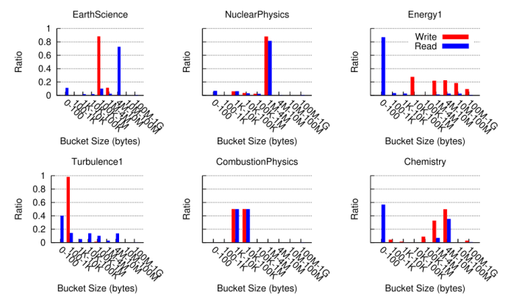
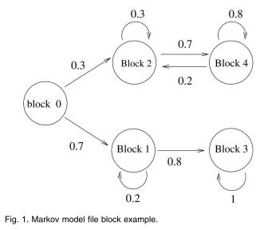
Coarse-granularity patterns are not precise enough. Statistics methods are lossy.
From 1. Thanks to Phil Carns.
From 7.
(DARSHAN) P. Carns, K. Harms, W. Allcock, C. Bacon, S. Lang, R. Latham, and R. Ross, “Understanding and improving computational science storage access through continuous characterization,” ACM Transactions on Storage (TOS), vol. 7, no. 3, p. 8, 2011.
B. Pasquale and G. Polyzos, “A static analysis of i/o characteristics of scientiﬁc applications in a production workload,” in Proceedings of the 1993 ACM/IEEE conference on Supercomputing. ACM, 1993, pp. 388–397.
E. Smirni and D. Reed, “Lessons from characterizing the input/output behavior of parallel scientiﬁc applications,” Performance Evaluation, vol. 33, no. 1, pp. 27–44, 1998.
S. Byna, Y. Chen, X. Sun, R. Thakur, and W. Gropp, “Parallel I/O prefetching using MPI ﬁle caching and I/O signatures,” in Proceedings of the 2008 ACM/IEEE conference on Supercomputing. IEEE Press, 2008, p. 44.
J. He, H. Song, X. Sun, Y. Yin, and R. Thakur, “Pattern-aware ﬁle reorganization in mpi-io,” in Proceedings of the sixth workshop on Parallel Data Storage. ACM, 2011, pp. 43–48.
T. Madhyastha and D. Reed, “Learning to classify parallel input/output access patterns,” Parallel and Distributed Systems, IEEE Transactions on, vol. 13, no. 8, pp. 802–813, 2002.
J. Oly and D. Reed, “Markov model prediction of i/o requests for scientiﬁc applications,” in Proceedings of the 16th international conference on Supercomputing. ACM, 2002, pp. 147–155.
N. Tran and D. Reed, “Automatic time series modeling for adaptive i/o prefetching,” Parallel and Distributed Systems, IEEE Transactions on, vol. 15, no. 4, pp. 362–377, 2004.

Slide 11
Methods

Slide 12
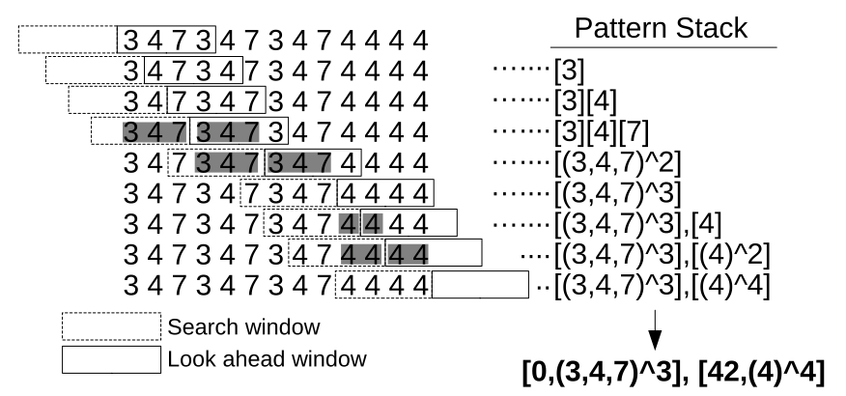
Sliding window algorithm is effective in discovering pattern.
Logical file:
Logical offsets:
0
3
7
14
17
21
28
31
35
42
46
50
54
58
stride list:
3
4
7
3
4
7
3
4
7
4
4
4
4
Complexity: O(wn). w is window size. n is input length.

Slide 13
Results

Slide 14
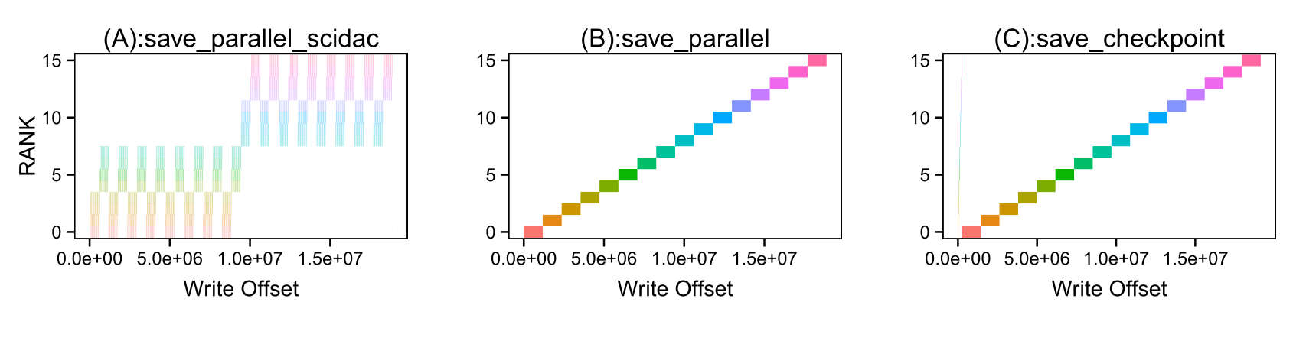
Patterns of real applications are explored, as well as benchmarks.
Applications explored:
LIVE RUN:
  Pagoda (PNNL), MPI-Blast, MILC, Montage (NASA), ADIOS (ORNL), MADBench2 (LBL)
TRACE REPLAY:
  Alegra (SNL), S3D (SNL), LANL anonymous applications, FLASH, BTIO
Benchmarks explored :
PATTERN-IO (NERSC), MPI-TILE-IO (ANL), FS-TEST (LANL)
Example: write patterns of MILC (physics app).
In-memory index compression rates by Pattern PLFS (higher is better):
(A):37.0; (B):3.0;(C):3.6

Slide 15
Write Performance Improvement
10⁶
Unchanged
Unchanged
1.5GB/s
512 processes with write size of 4K.

Slide 16
Read Performance Improvement
480%
Uniform read: 512 processes
Non-uniform read: 256 processes

Slide 17
PLFS metadata can be reduced by up to several orders of magnitude.
1500

Slide 18
Conclusions & Future Work

Slide 19

The proposed sliding window algorithm is effective on discovering structure and improving I/O performance.
Application patterns are studied.
I/O structure discovering algorithm and a
compact structure representation are proposed.
Metadata is reduced and
I/O performance is improved.

Slide 20
The proposed techniques have the potential for being applied in other systems.
Predictability & Compactness
Pre-fetching
Block pre-allocation
Data layout optimization
SciHadoop metadata compression

Slide 21
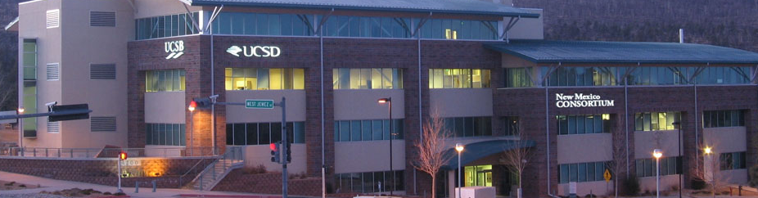
Acknowledgement
Michael Lang (Los Alamos National Laboratory)
Adam Manzanares (California State University)
All the reviewers
This work was performed at the Ultrascale Systems Research Center (USRC) at Los Alamos National Laboratory, supported by the U.S. Department of Energy DE-FC02-06ER25750. The publication has been assigned the LANL identiﬁer LA-UR-12-25954.

Slide 22
Q & A
Jun’s email: junnhe@gmail.com

